Slide 1
UBER CASE STUDY 10-June-2018
Name: Ravi Divecha

Slide 2
Business Objective
This case study is to study the demand supply gap for Uber customers who book cabs to travel from airport to city and from city to airport.
The root cause analysis from this case study will be to provide recommendations to improve demand supply gap.
The aim of analysis is to identify the root cause of the problem (i.e. cancellation and non-availability of cars) and recommend ways to improve the situation. As a result of your analysis, you should be able to present to the client the root cause(s) and possible hypotheses of the problem(s) and recommend ways to improve them.

Slide 3
Approach Followed
Uber cab data is evaluated and cleansed for further data analysis.
Visual identification of the most pressing problems for Uber.
Gap between supply and demand.
Plots created to visualize the frequency of requests that get cancelled or show 'no cars available’;
Identify time slots with the highest supply demand gap
Identify types of requests (city-airport or airport-city) for which the gap is the most severe in the identified time slots.
Conclusion and Recommendations

Slide 4
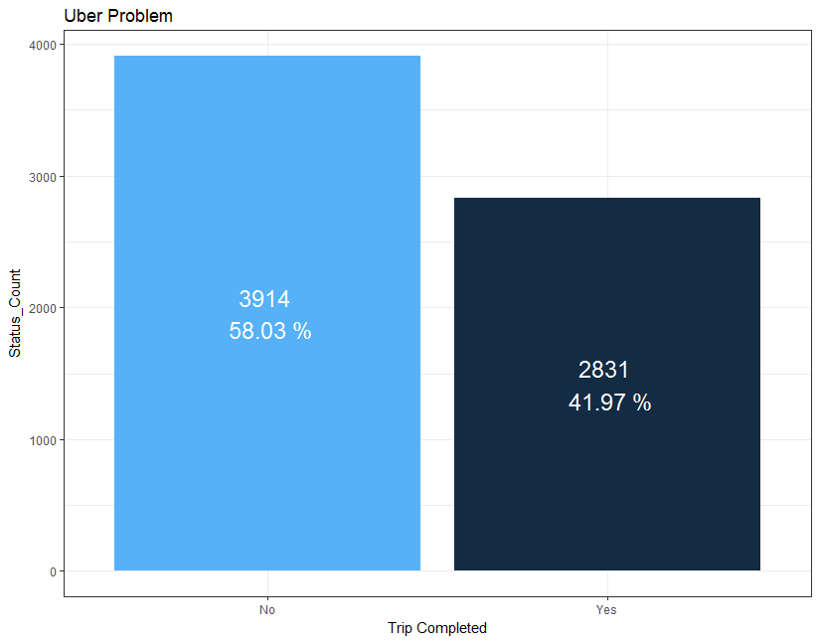
Uber Problem Identification
The most pressing problem for Uber is that out of a total of 6745 rides, 58% of them are not accomplished.
Further analysis is required to identify the root cause of this problem.

Slide 5
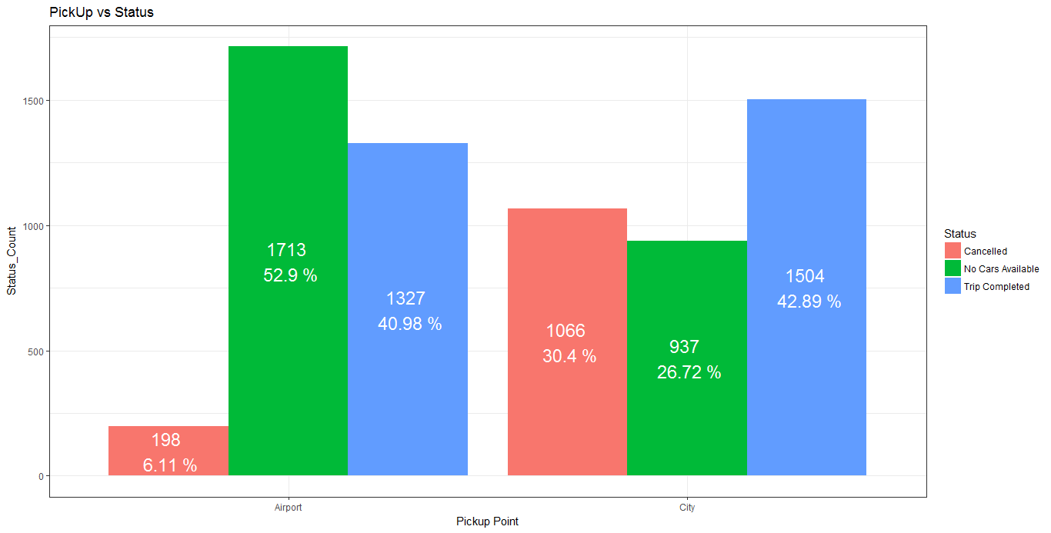
Uber Problem Analysis .. 1
Analysis conducted on pickup point shows 2 main observations for reason of trip not being completed.
Pickup point airport has shortage of cab for 53% of trip requests from airport.
Pickup point from city has cancellation of cabs for 30% of trip requests from city.

Slide 6
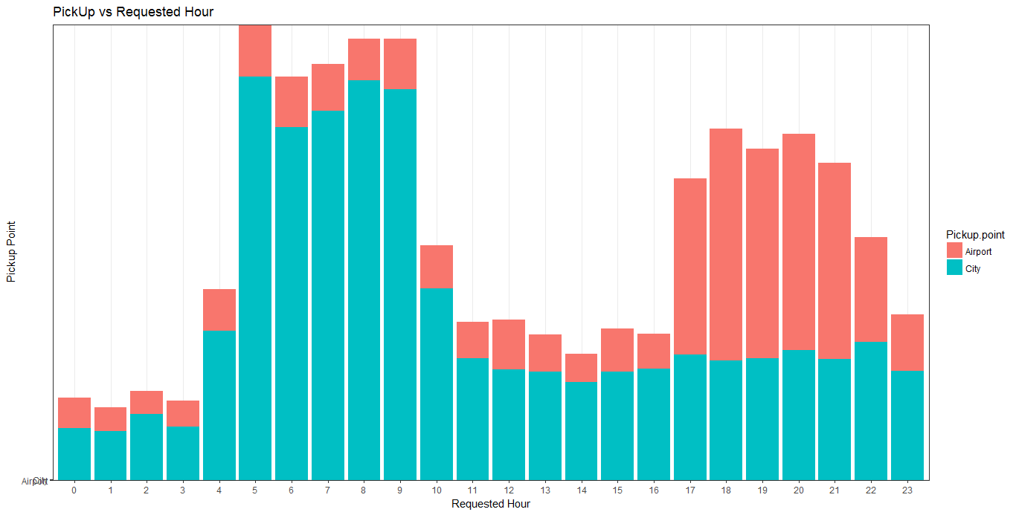
Uber Problem Analysis .. 2
High request from City to Airport
High request from Airport to City
Uber cab distribution on an hourly basis shows that there are frequent requests from city to airport during the day and frequent requests from airport to city during evening.

Slide 7
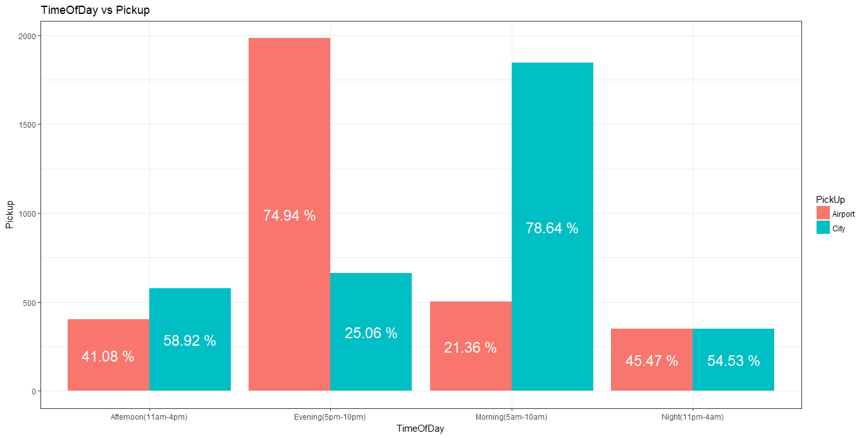
Uber Problem Analysis .. 3
High demand
during evening
High demand
during morning
Uber cab distribution for time of day shows
During evenings (5pm-10pm) there is high demand for cabs from city to airport
During mornings (5am-10am) there is high demand for cabs from airport to city

Slide 8
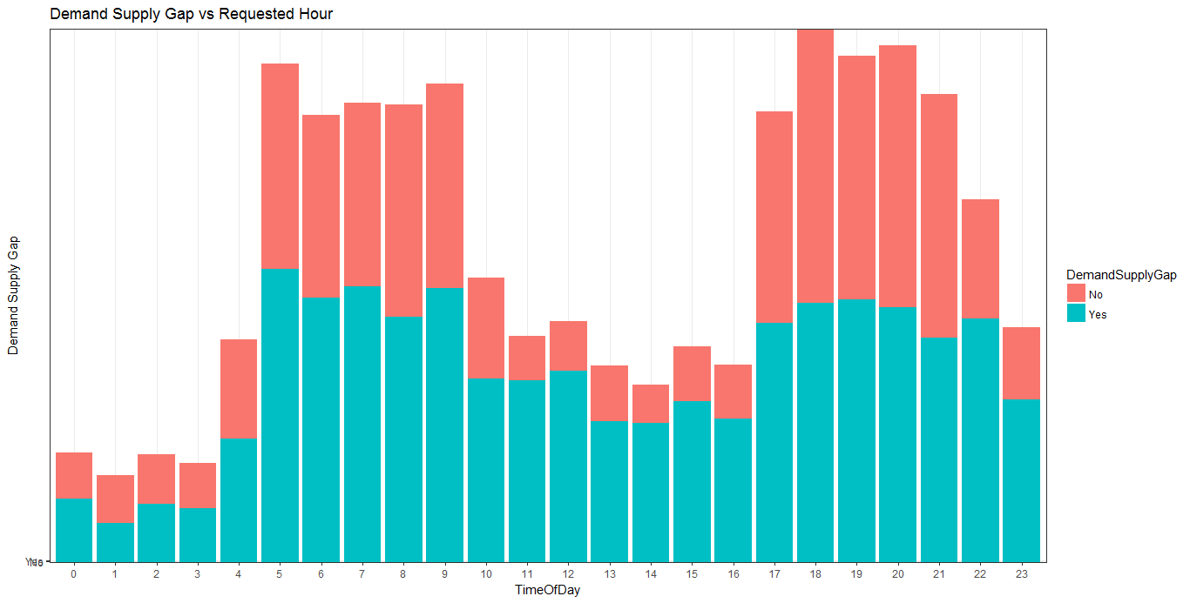
Uber Problem Analysis .. 4
Uber cab distribution on an hourly basis shows that there is always a gap between demand and supply at any given hour of the day.

Slide 9
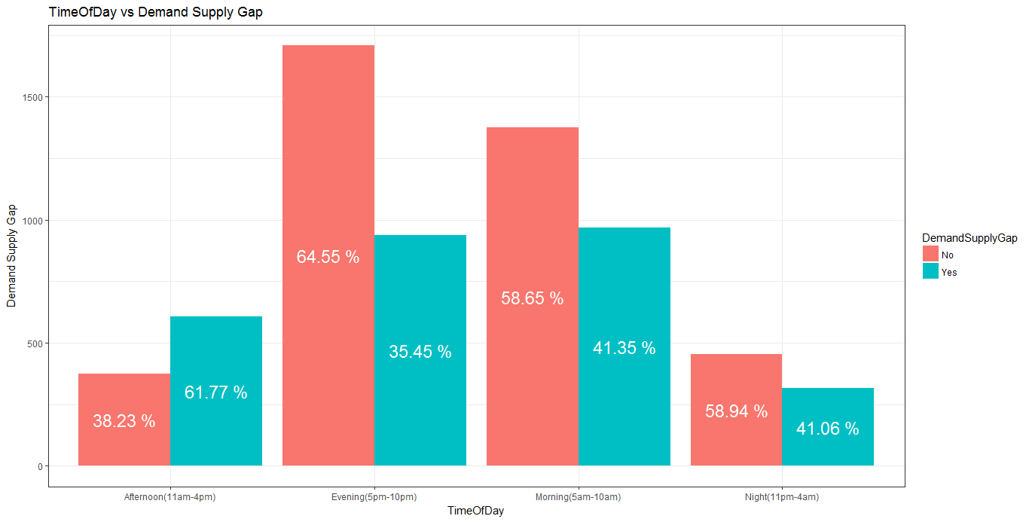
Uber Problem Analysis .. 5
Highest demand supply gap
High demand supply gap
Uber cab distribution for time of day shows
During evenings (5pm-10pm) there is the highest supply demand gap for 65% of requests.
During mornings (5am-10am) there is supply demand gap for 59% of requests.

Slide 10
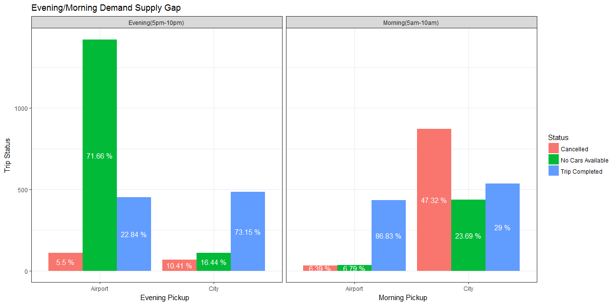
Uber Problem Analysis .. 6
The major problem areas for Uber are as under
During evenings (5pm-10pm) 72% of trips from airport are not completed because of no cars available.
During mornings (5am-10am) 47% of trips from city are not completed because of cabs cancellation.

Slide 11
CONCLUSIONS
Analysis | Hypothesis | Recommendation
Uber cab data from city to airport and airport to city reveals that only 42% of trips are completed indicating major gap in demand and supply. | 1. There might be a shortage of Uber cab offerrings to customer or customers might look for alternate arrangements(competitors, local transport) for their requirements | 1. Higher availability of cabs for Uber customers. 2. Encourage Uber share for customers. 3. Offer discount coupons for loyal customers
Data collected for various timeslots in the day indicate that evening and morning slots are the worse affected for demand supply gap. | 1.High number of flights departing from airport or arriving at airport resulting in high demand in these time slots | 1. Give higher incentive to cab drivers to operate in specific timeslots of the day. 2. Offer completed trips as 1.5 times to cab drivers.
During the evening, 70% of airport to city demand cannot be met due to unavailability of cabs. | 1. Shortage of cabs travelling from city to airport during the day might might cause demand supply gap. 2. Corporate customers returning to their city. | 1. Provide lunch to cab drivers to stay at airport once they arrive to airport in the morning. 2. Have corporate tie-ups by pre-booking cabs at specific time slots.
During the morning, 47% of city to airport demand cannot be met due to cancelling of requests. | 1. Cab drivers in the morning prefer to do city rides 2. Passengers have other options for travel to airport. 3. High number of corporate travellers in the morning. | 1. Provide incentive to drivers for trips to airport. 2. Provide incentive to loyal customers to stay with Uber. 3. Have tie up with corporate companies to pre-book cabs.
Average trip time from completed time is 52mins | 1. Average travel time for drivers might be higher than other trips during the day | 1. Develop a system to provide points on number of kilometers travelled instead of number of trips completed per day.

